Slide 1
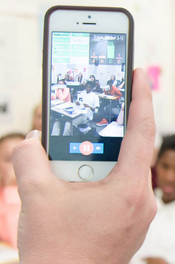
Plickers
Brian Novick

Slide 2
Today…
How can you use Plickers in your class?
Where should you start?
What tips do you have for a first time user?

Slide 3
How can you use Plickers in your class?

Slide 4
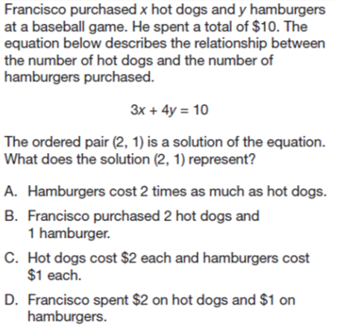
PSSA/ Keystone
Prep

Slide 5
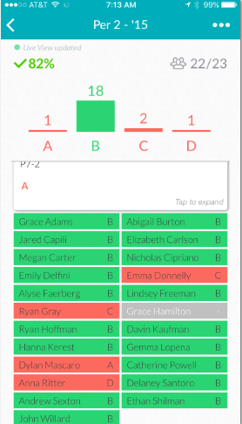
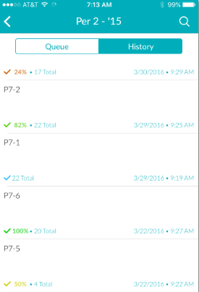
Multiple Choice
Results in
Plickers

Slide 6
How can you use Plickers in your class?
Formative Assessment
“Formal and Informal Checks for Understanding”
PSSA/Keystone Review
Determine who needs help.
Determine if your class is ready to move on.
SUMMARY

Slide 7
Where should you start?

Slide 8
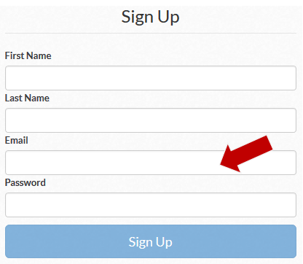
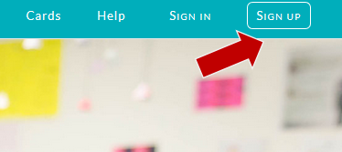
Where should you start?
Step 2: Fill out the form
Step 1: Sign-Up
Create an account

Slide 9
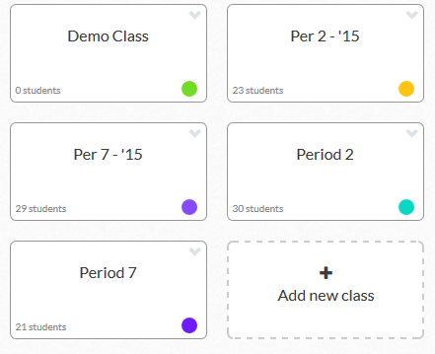
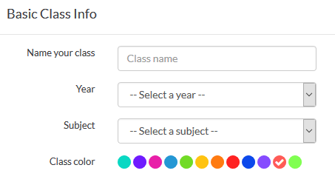
Where should you start?
Create a new class
Step 1: Go to Classes
Step 2: Click Add new class
Step 3: Enter basis class
Info.

Slide 10
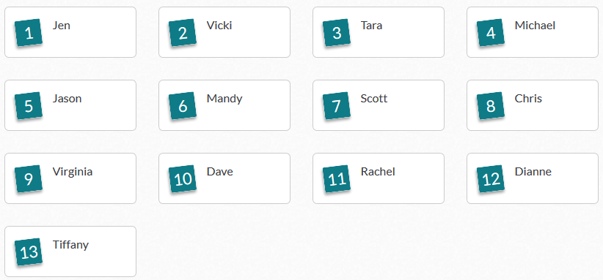
Where should you start?
Step 4: Add students to your class.
Step 5: Add Roster
Create a new class

Slide 11
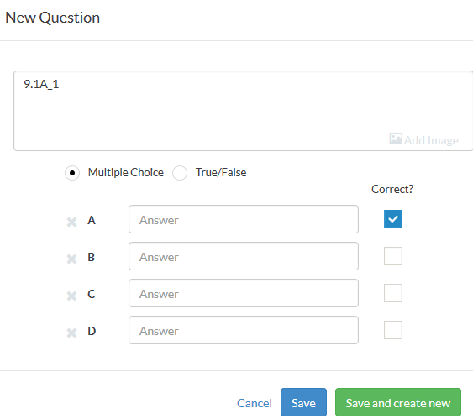
Where should you start?
Step 1: Go to the Library
Create assignments
Step 2: New Question
Step 3: Add to Queue
(You can select multiple
classes.)

Slide 12
What tips do you have for a first time user?

Slide 13
What tips do you have for someone getting started?
It is not necessary to enter the exact question into plickers. Instead you can enter “Q1” and then project the question on your projector/smartboard.
You can create questions on your phone/tablet
Pick a class period. Select Queue. Select Create.
The downside is that you cannot easily copy the question to other classes. (It is easy to do this in the web version).

Slide 14
Today…
How can you use Plickers in your class?
Where should you start?
What tips do you have for a first time user?

